Slide 1
Programming in C
Module 1.1, 1.2

Slide 2
Topics for today
Syllabus in brief
Marking scheme
Language/computer language
Need of computer language
Why to study C?
Platform dependency in C

Slide 3
Introduction
What is Language?
What is Computer Language?
Follow set of instructions/ programs
Application/ software

Slide 4

Introduction: Need of Computer Language
English
Hindi
etc.

Slide 5
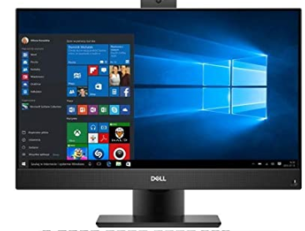
Introduction: Need of Computer Language
English
Hindi
etc.
communication
Binary
10110…

Slide 6
Introduction: Need of Computer Language
English
Hindi
etc.
X
communication
Binary
10110…

Slide 7
Introduction: Need of Computer Language
High level languages
English
Hindi
etc.
C
C++
Java
Python, R etc.
using
X
communication
Binary
10110…

Slide 8
Introduction: Need of Computer Language
High level languages
English
Hindi
etc.
C
C++
Java
Python, R etc.
Writing programs
using
X
communication
a = 2;
b=6;
c=a + b;
Print c.
Binary
10110…

Slide 9
Introduction: Need of Computer Language
High level languages
English
Hindi
etc.
C
C++
Java
Python, R etc.
Writing programs
using
X
communication
10110100
1000
10011
111101
a = 2;
b=6;
C=a + b;
Print c.
Binary
10110…
Compiler

Slide 10
Introduction: Need of Computer Language
High level languages
English
Hindi
etc.
C
C++
Java
Python, R etc.
Writing programs
using
X
communication
10110100
1000
10011
111101
a = 2;
b=6;
C=a + b;
Print c.
Binary
10110…
Compiler

Slide 11
Problem solving skill development: Logical skills, Algorithms and flowcharts
Problem: Print 1 to 20 numbers
Algorithm:
Step 1: Initialize variable “a” = 0;
Step 2: Increment “a”
Step 3: Print “a”
Step 4: Check “a” is less than 20, goto Step 2

Slide 12
Problem solving skill development: Logical skills, Algorithms and flowcharts
A graphical or diagrammatical representation of an algorithm is Flowchart
Problem: Print 1 to 20 numbers
Algorithm:
Step 1: Initialize variable “a” = 0;
Step 2: Increment “a”
Step 3: Print “a”
Step 4: Check “a” is less than 20, goto Step 2
Start
a = 0
a = a + 1
Print a
a < 20?
end

Slide 13
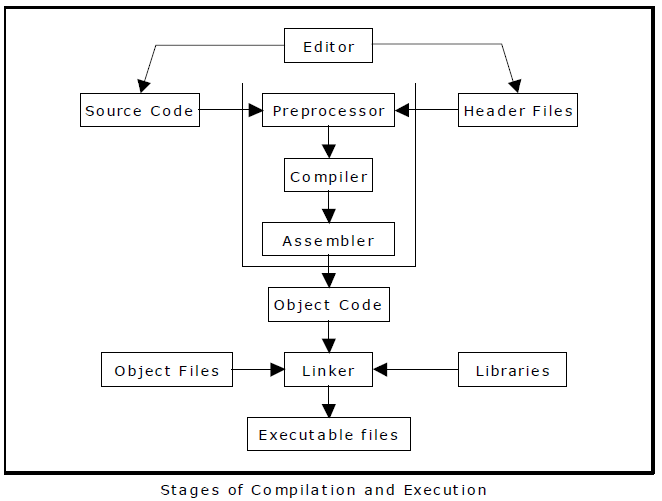
Compiling & Executing C Program

Slide 14
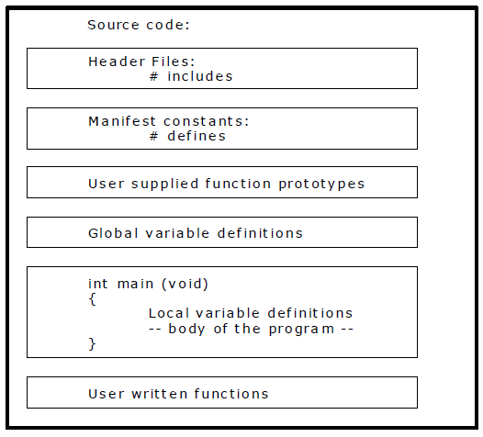
Simple C program structure:

Slide 15
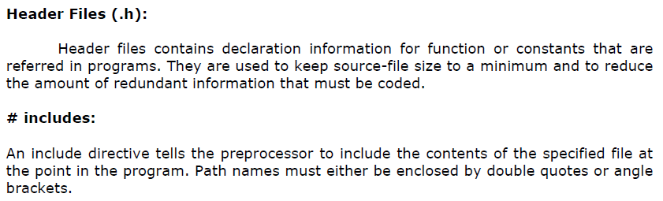
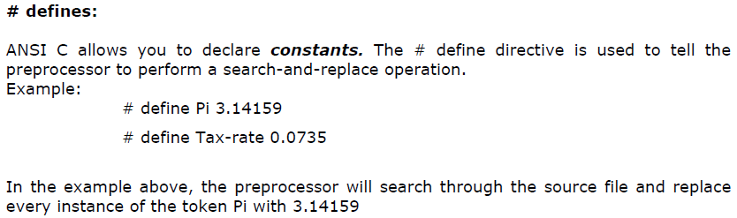
Simple C program structure:

Slide 16
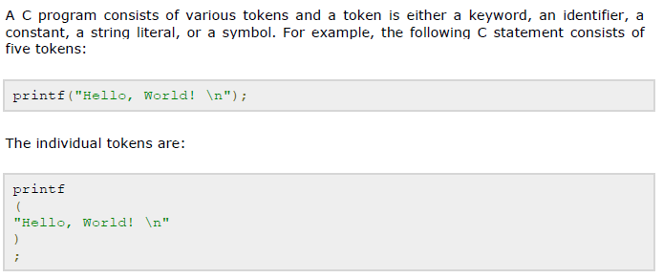
Elements of C program
Token in C

Slide 17
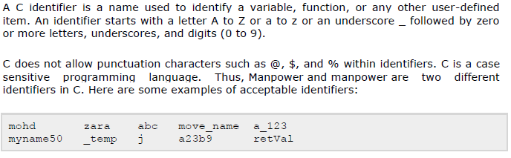
Elements of C program
Identifiers in C

Slide 18
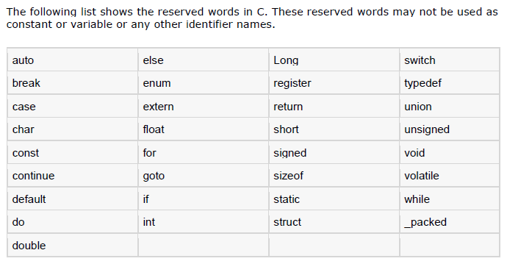
Elements of C program
Keywords in C
Compiler specific

Slide 19
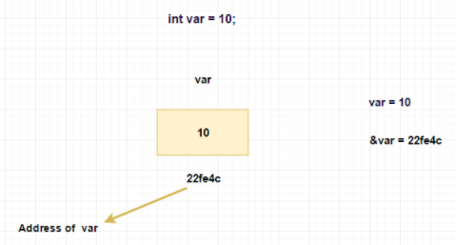
Elements of C program
Constants and variables in C
A constant is an entity that doesn’t change whereas a variable is an entity that may change.

Slide 20
Elements of C program
Constants and variables in C
A constant is an entity that doesn’t change whereas a variable is an entity that may change.
Variable
Constant
Since the location whose name is var can hold different values at different times, var is known as a variable. As against this, 10 or 5 do not change, hence are known as constants.

Slide 21
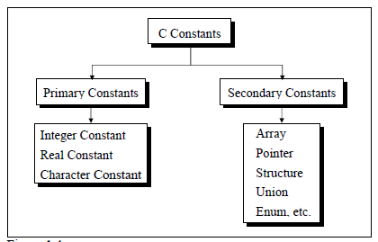
Elements of C program
Types of Constants in C

Slide 22
Elements of C program
Rules for Constructing Integer Constants in C
(a) An integer constant must have at least one digit.
(b) It must not have a decimal point.
(c) It can be either positive or negative.
(d) If no sign precedes an integer constant it is assumed to be positive.
(e) No commas or blanks are allowed within an integer constant.
(f) The allowable range for integer constants is -32768 to 32767.

Slide 23
Elements of C program
Rules for Constructing Character Constants in C
(a) A character constant is a single alphabet, a single digit or a single special symbol enclosed within single inverted commas. Both the inverted commas should point to the left.
For example, ’A’ is a valid character constant whereas ‘A’ is not.
(b) The maximum length of a character constant can be 1 character.
Ex.:
'A'
'I'
'5'
'='

Slide 24
Elements of C program
Rules for Constructing Variable Names in C
(a) A variable name is any combination of 1 to 31 alphabets, digits or underscores. Some compilers allow variable names whose length could be up to 247 characters. Still, it would be safer to stick to the rule of 31 characters. Do not create unnecessarily long variable names as it adds to your typing effort.
(b) The first character in the variable name must be an alphabet or underscore.
(c) No commas or blanks are allowed within a variable name.
(d) No special symbol other than an underscore (as in gross_sal) can be used in a variable name.
Ex.: si_int
m_hra
pop_e_89

Slide 25
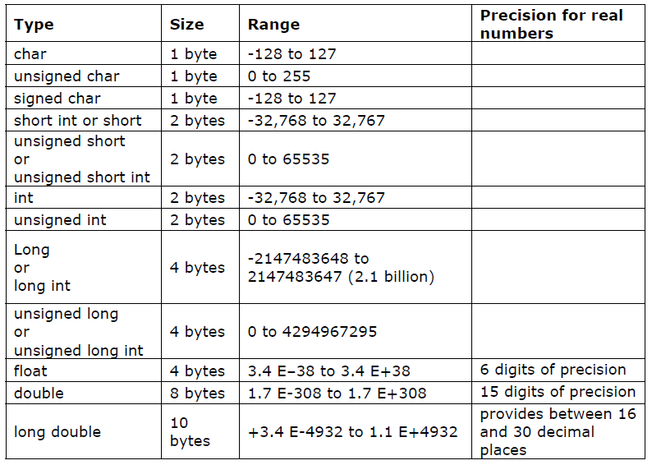
Elements of C program
Data types in C

Slide 26
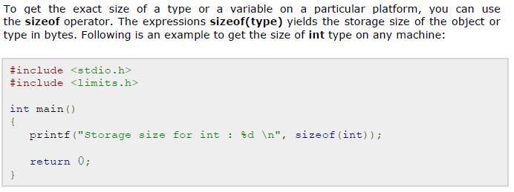
Elements of C program
Data types in C

Slide 27
Program to take input of various datatypes in C
Taking integer as input from user: input and display two numbers at a time
Taking float as input from user
Taking character as input from user

Slide 28
Program to take input of various datatypes in C
%d and %i, both are used to take numbers as input from the user.
%f is the format specifier to take float as input from the user
%c is the format specifier to take character as input from the user

Slide 29
Program to take input of various datatypes in C
Lets try this
int a=25;
float b=5.67;
char ch=‘g’;
char s[]=“Hello”;
printf ( "\n%c %d %f", ch, ch, ch ) ;
printf ( "\n%s %d %f", s, s, s ) ;
printf ( "\n%c %d %f",a ,a, a ) ;
printf ( "\n%f %d\n", b, b ) ;

Slide 30
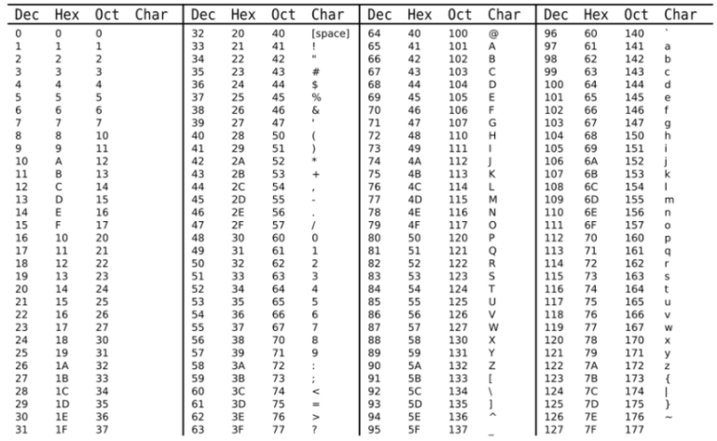
ASCII value table Dec=ASCII value

Slide 31
Elements of C program
Local and Global Variables in C
Local Variable:
The variables which are declared inside the function, compound statement (or block) are called Local variables.
void function_1()
{
int a, b; // you can use a and b within braces only
}
void function_2()
{
printf("%d\n", a); // ERROR, function_2() doesn't know any variable a
}

Slide 32
Elements of C program
Local and Global Variables in C
Local Variable:
The variables which are declared inside the function, compound statement (or block) are called Local variables.
int main()
{
int a = 100;
{
int a = 10;
printf("Inner a = %d\n", a);
}
printf("Outer a = %d\n", a);
return 0;
}

Slide 33
Elements of C program
Local and Global Variables in C
Global Variable:
The variables declared outside any function are called global variables.
They are not limited to any function.
Any function can access and modify global variables.
Global variables are automatically initialized to 0 at the time of declaration.
Global variables are generally written before main() function.

Slide 34
#include<stdio.h>
void func_1();
void func_2();
int a, b = 10; // declaring and initializing global variables
int main()
{
printf("Global a = %d\n", a);
printf("Global b = %d\n\n", b);
func_1();
func_2();
return 0;
}
void func_1()
{
printf("From func_1() Global a = %d\n", a);
printf("From func_1() Global b = %d\n\n", b);
}
void func_2()
{
int a = 5;
printf("Inside func_2() a = %d\n", a);
}

Slide 35
Elements of C program
Constants in C
#include <stdio.h>
#define num 25
#define pi 3.14
int main() {
float p, r=2.5;
printf("The value of pi is: %f", pi);
p= 2* pi *r;
printf("The value of perimeter is: %f", p);
return 0;
}

Slide 36
Elements of C program
Input/output functions
There are numerous library functions available for I/O. These can be classified into two broad categories:
Console I/O functions - Functions to receive input from keyboard and write output to VDU.
(b) File I/O functions - Functions to perform I/O operations on a floppy disk or hard disk.
In this chapter we would be discussing only Console I/O functions.

Slide 37
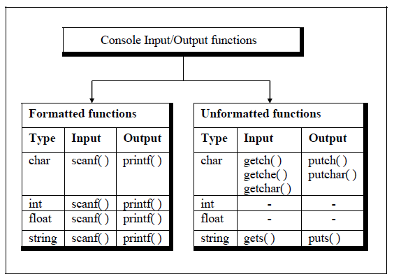
Elements of C program
Console Input/output functions

Slide 38
Elements of C program
Formatted console Input/output functions
The formatted functions allow the input read from the keyboard or the output displayed on the VDU to be formatted as per our requirements.
For example, if values of average marks and percentage marks are to be displayed on the screen, then the details like where this output would appear on the screen, how many spaces would be present between the two values, the number of places after the decimal points, etc. can be controlled using formatted functions.

Slide 39
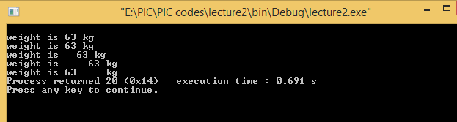
Elements of C program
Formatted console Input/output functions-Format Specifiers
main( )
{
int weight = 63 ;
printf ( "\nweight is %d kg", weight ) ;
printf ( "\nweight is %2d kg", weight ) ;
printf ( "\nweight is %4d kg", weight ) ;
printf ( "\nweight is %6d kg", weight ) ;
printf ( "\nweight is %-6d kg", weight ) ;
}
The output of the program would look like this ...

Slide 40

Elements of C program
Formatted console Input/output functions-Format Specifiers
/* Formatting strings with printf( ) */
main( )
{
char firstname1[ ] = "Sandy" ;
char surname1[ ] = "Malya" ;
char firstname2[ ] = "AjayKumar" ;
char surname2[ ] = "Gurubaxani" ;
printf ( "\n%20s%20s", firstname1, surname1 ) ;
printf ( "\n%20s%20s", firstname2, surname2 ) ;
}
And here’s the output...
Columns

Slide 41
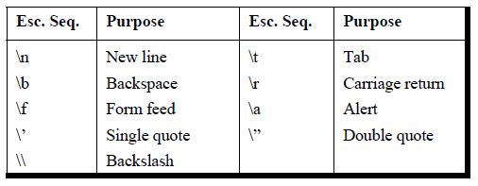
Elements of C program
Formatted console Input/output functions- Escape sequences

Slide 42
Elements of C program
UnFormatted console Input/output functions

Slide 43
Elements of C program
UnFormatted console Input/output functions
main( )
{
char ch ;
printf ( "\nPress any key to continue" ) ;
getch( ) ; /* will not echo the character */
printf ( "\nType any character" ) ;
ch = getche( ) ; /* will echo the character typed */
printf ( "\nType any character" ) ;
getchar( ) ; /* will echo character, must be followed by enter key */
printf ( "\nContinue Y/N" ) ;
fgetchar( ) ; /* will echo character, must be followed by enter key */
}
main( )
{
char ch = 'A' ;
putch ( ch ) ;
putchar ( ch ) ;
fputchar ( ch ) ;
putch ( 'Z' ) ;
putchar ( 'Z' ) ;
fputchar ( 'Z' ) ;
}

Slide 44
Elements of C program
UnFormatted console Input/output functions
The limitation of putch( ), putchar( ) and fputchar( ) is that they can output only one character at a time.
Solution:
gets( ) and puts( )
gets( ) receives a string from the keyboard. Why is it needed?
Because scanf( ) function has some limitations:
main( )
{
char name[50] ;
printf ( "\nEnter name " ) ;
scanf ( "%s", name ) ;
printf ( "%s", name ) ;
}

Slide 45
Elements of C program
UnFormatted console Input/output functions –gets() and puts()
The solution to this problem is to use gets( ) function.
As said earlier, it gets a string from the keyboard.
It is terminated when an Enter key is hit. Thus, spaces and tabs are perfectly acceptable as part of the input string.
More exactly, gets( ) gets a newline (\n) terminated string of characters from the keyboard and replaces the \n with a \0.
The puts( ) function works exactly opposite to gets( ) function. It outputs a string to the screen.
Here is a program which illustrate

Slide 46
Elements of C program
UnFormatted console Input/output functions –gets() and puts()
main( )
{
char footballer[] ;
puts ( "Enter name" ) ;
gets ( footballer ) ; /* sends base address of array */
puts ( "Happy footballing!" ) ;
puts ( footballer ) ;
}

Slide 47
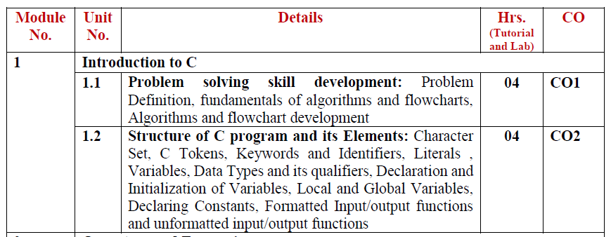
Elements of C program
Completed first module from syllabus

Slide 48
Program to display your complete name, roll no., department, college and 12th percentage entered from the user in C

Slide 49
Program to swap two numbers entered by user in C
Input: a= 67, b=32;
Output: a=32,b=67

Slide 50
The length & breadth of a rectangle and radius of a circle are input through the keyboard. Write a program to calculate the area & perimeter of the rectangle, and the area & circumference of the circle.

